Slide 1
Mainframe DevOps Approach
Aug 26, 2018

Slide 2
Challenges in Mainframe - DevOps
DevOps Challenges
Mindset Problem
Tooling
Continuous Editing
Lost Code
Lack In Modularity
Architectural
Constraint
Long Release cycles for simple application update
Access to test data quickly and easily by Developers and testers, in order to adhere to compressed go-live schedules
Software development effort to encounter slowdowns as mobile/distributed teams work in very different silos from mainframe teams.
Fractured Ecosystem for Mainframe
Evolving the Mainframe to keep up with DevOps
MIPS Costs
Lack of Automation, Lost Code
Continuous Editing
Attracting Talents

Slide 3
Mainframe DevOps – Planning and Strategy
Despite these challenges, mainframe software applications shouldn’t be thought of differently than frontend development or any other application development. The same methodologies that are applied to speed up facilitated software development and deployment on the cloud or on premises can be applied to mainframe software development and deployment.
Feasibility, Assessment and Questioner
Unify mainframe application asset change management to ease orchestration
Track and Plan everything
Adopt a test-everything strategy using continuous integration build approach with (automated) self-validating builds
Document standardized environments and drive cloud provisioning of isolated mainframe images and applications based on standards
Optimize provisioning orchestration to include dependency virtualization and test data conditioning
DevOps practices to force linkages separate application system, automation, and standardized packaging
Dashboard and Monitoring everything

Slide 4

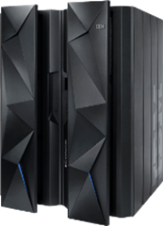
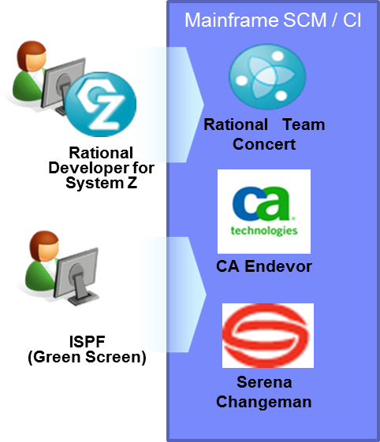

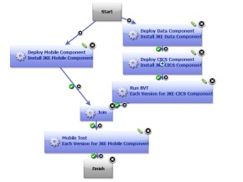
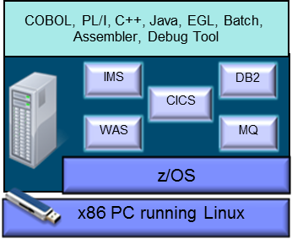
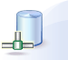
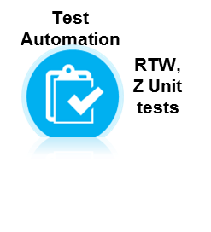
Mainframe CI/CD
IBM UrbanCode
Deploy for z/OS
Deploy
Code Station
on z/OS
Test Environment – RD&T
Continuously test in production-like env.
Third-party Services
Application under test
Download build output from Code Station on z/OS
Deploy to z/OS or RD&T to test application changes
Dynamic In
Promote
Value from planned unified solution
z/OS application testing on emulated
z System hardware
Accelerate delivery and reduces cycle time to develop/test multi-tier applications across heterogeneous environments and platforms
Reduce costs and eliminate delays for delivering mainframe applications
Minimize risk and improve productivity across disparate teams with cross-platform release planning

Slide 5
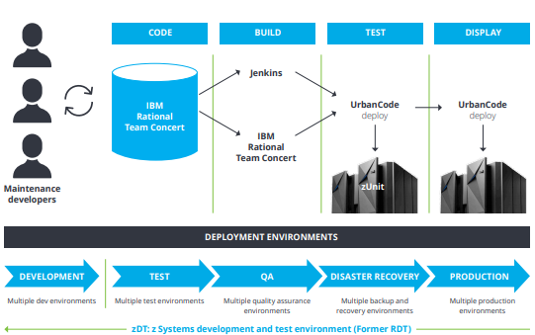
DevOps Tool Chains
Organizations have the potential to achieve a better and more agile way of mainframe software development and deployment—one that increases collaboration and automation by using a DevOps pipeline and tools. To test this point-of-view, IRIS evaluated IBM’s DevOps capabilities for z/OS® Mainframe Systems against today’s best DevOps practices. A stack of modernized DevOps pipeline and tools products by IBM for z Systems mainframes can be installed and configured in a sandbox environment. First, a brief assessment of the following IBM software suite of products can be performed
IDz (IBM Developer for z Systems), an IDE based on Eclipse that supports z/OS systems software development.
IBM’s RTC (Rational Team Concert), essentially a team orchestration and collaboration tool with advanced features for workflow assignment and tracking as well as debugging and building automation.Track and Plan everything
Alternative : Jenkins for CI
zUnit Test, a suite of capabilities within RTC that enables automated unit testing.
UCD (Urban Code Deploy), a package management tool that enables fast and reliable code and solution deployment.
Virtual components
Third-party Services
Dynamic In
QA
Simultaneously test across multiple test stages
z/OS application testing on emulated
z System hardware

Slide 6

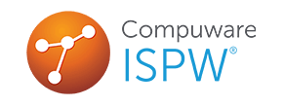
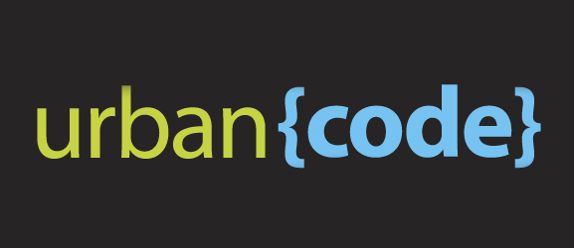
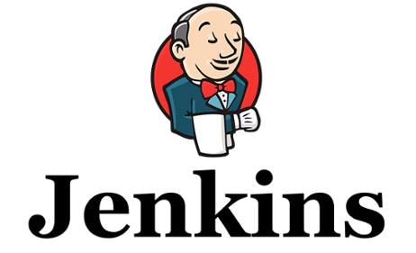
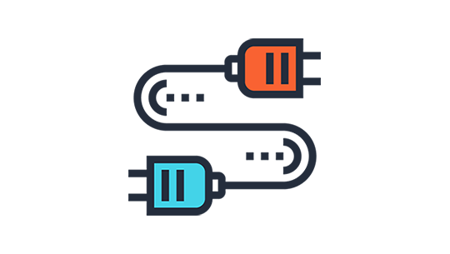







Solution : Mainframe DevOps Pipeline
Z/OS LPAR, Build system
Trigger Deployment
Z/OS LPAR, Target Environment
Mainframes SCM Tool
Compuware SCM plugin:
Check out the Mainframe
source code
IBM Z/OS connector
Submit JCL Job
Deploy (z/OS Agent)
Build System
Deploy Server
Jenkins Job
Configuration
Dynamic In
Source code
Virtual components
Post Build
Script
Code Station
Download
Artefacts
Desktop
2
1
1
1
TSO, REXX,
SHELL, JCL
Deploy (z/OS Agent)
Deploy
Data sets
QA
Dynamic In
Dynamic In
Create Component
Versions
Agent/buzztool.sh
TSO, REXX,
SHELL, JCL
Update Status of
Deployment
&
Inventory
Source code Checkout
Code Quality Analysis
Compile Mainframe code
DevOps Pipeline

Slide 7
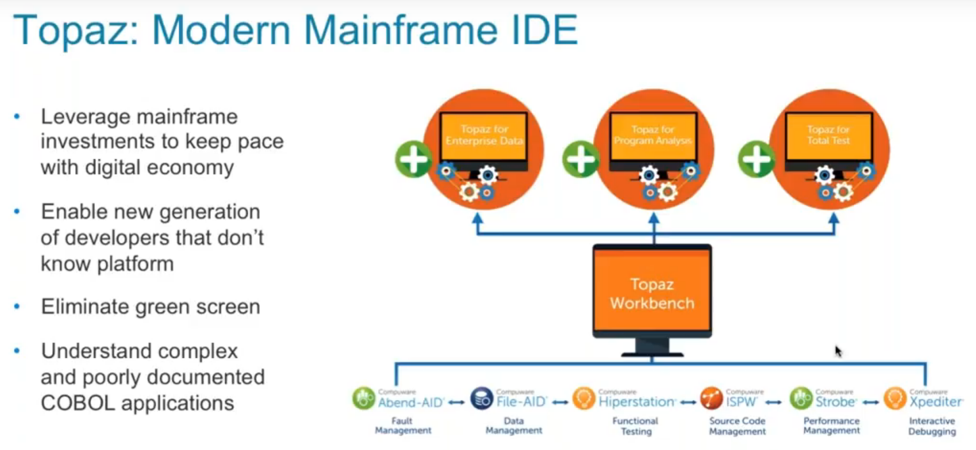
Mainframe DevOps Approach :Compuware Topaz & ISPW
Topaz provides the base capabilities which provides rich features like soutce code editing, fault diagnostic, functional testing, performance management and debugging and then it also have additional features such as
Topaz for Program Analysis - Allows developers to understand complex applications and quickly make changes.
Topaz for Enterprise Data – Allows developers to understand data relationship inside mainframe and across distributed platforms
Topaz for Total Test – Provides unique cutting edge solution that allows customer to have unit testing for mainframe.

Slide 8
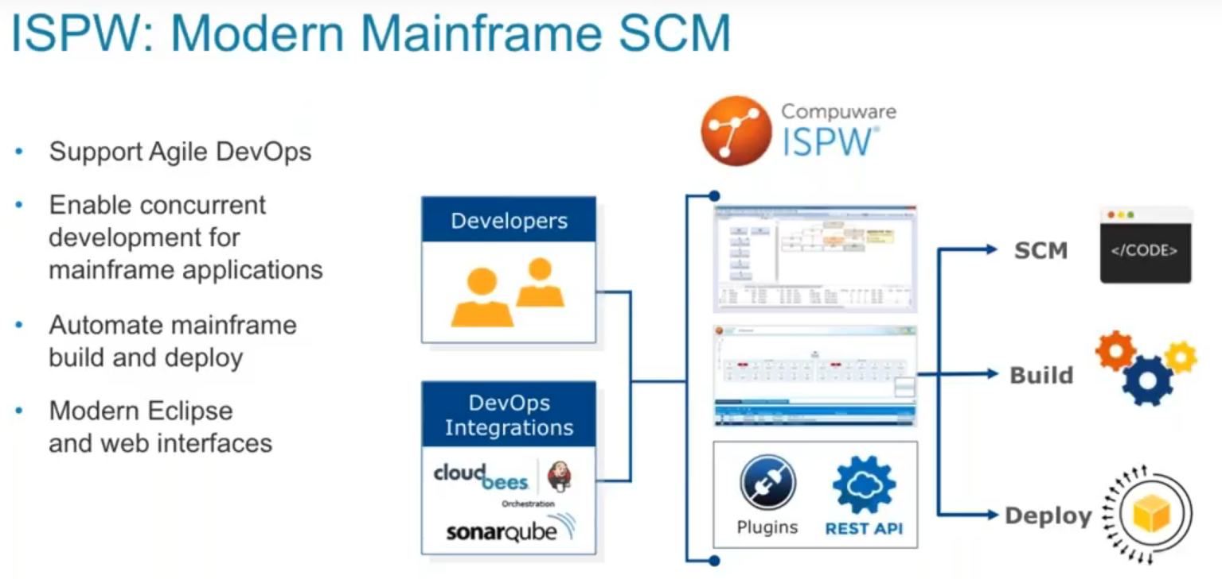
Mainframe DevOps Approach :Compuware Topaz & ISPW
ISPW have integration with Jenkins and also have REST API support.
ISPW handles the following for mainframe applications –
Source Code Management aspect of mainframe source code
Build & Compilation process
Deployment process
ISPW handles the following for mainframe applications –

Slide 9
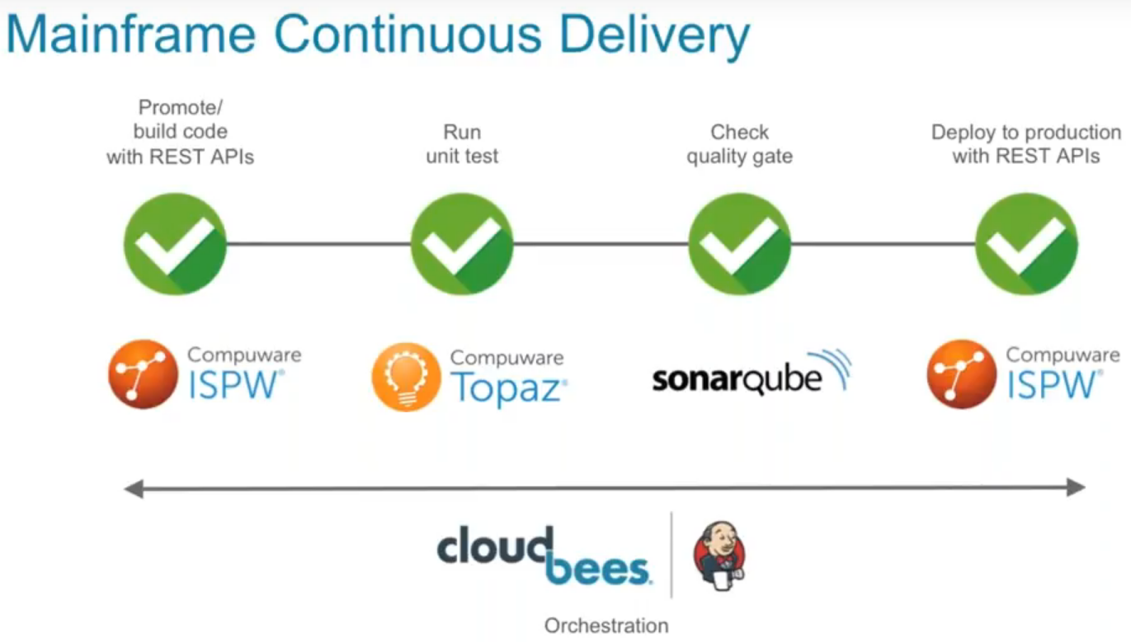
Mainframe DevOps Approach :Compuware Topaz & ISPW

Slide 10
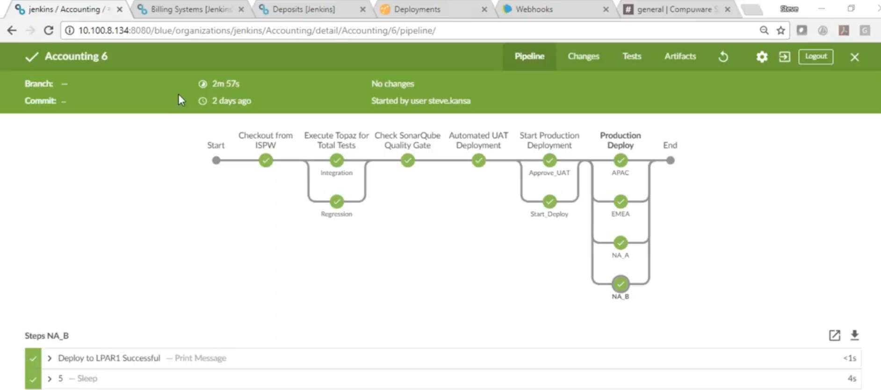
Mainframe DevOps Approach :Compuware Topaz & ISPW

Slide 11
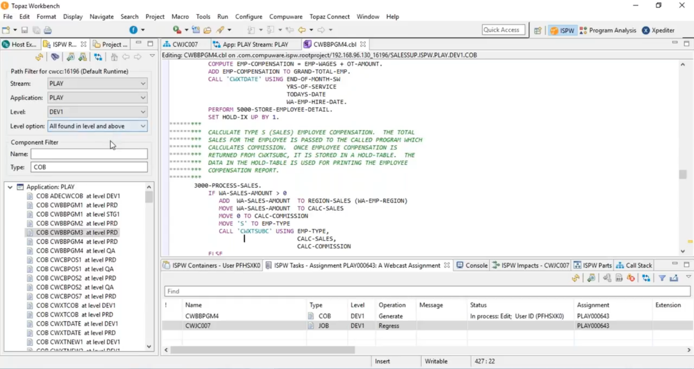
Mainframe DevOps Approach :Compuware Topaz & ISPW
The above is a Cobol program opened inside ISPW.

Slide 12
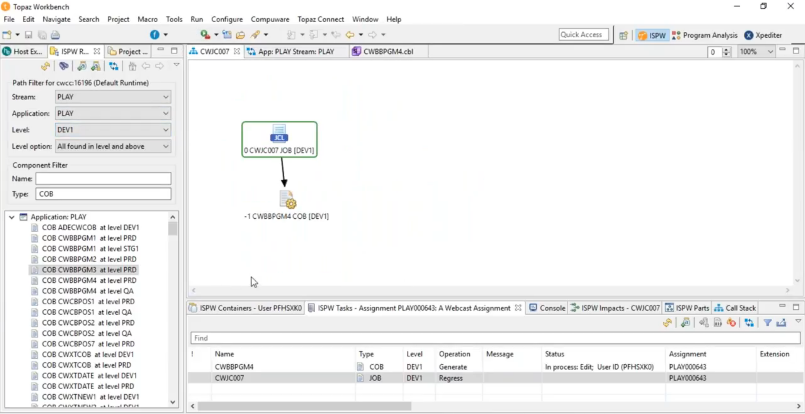
Mainframe DevOps Approach :Compuware Topaz & ISPW
Now which JCL will trigger this Cobol program can be identified from within the ISPW, as you can see above.

Slide 13
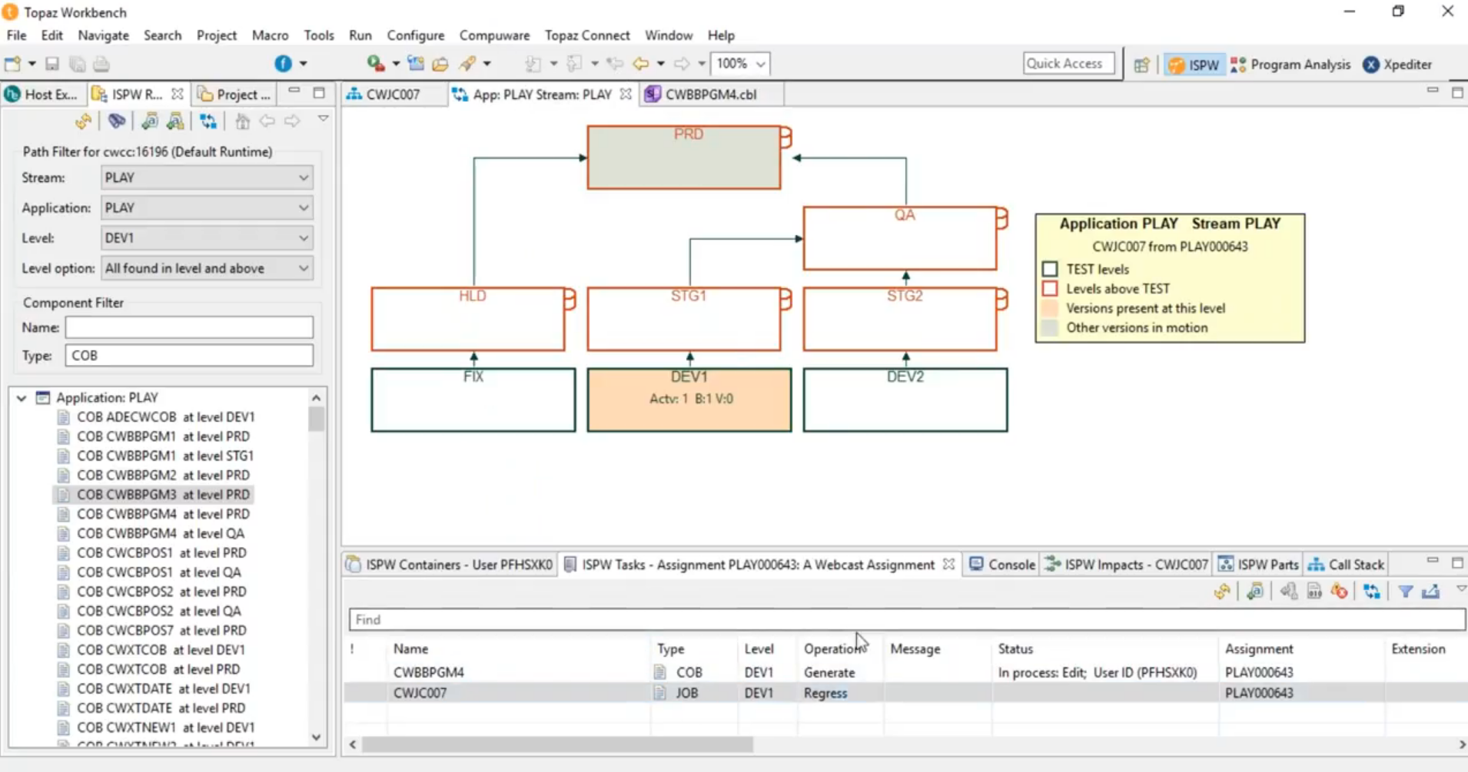
Mainframe DevOps Approach :Compuware Topaz & ISPW

Slide 14
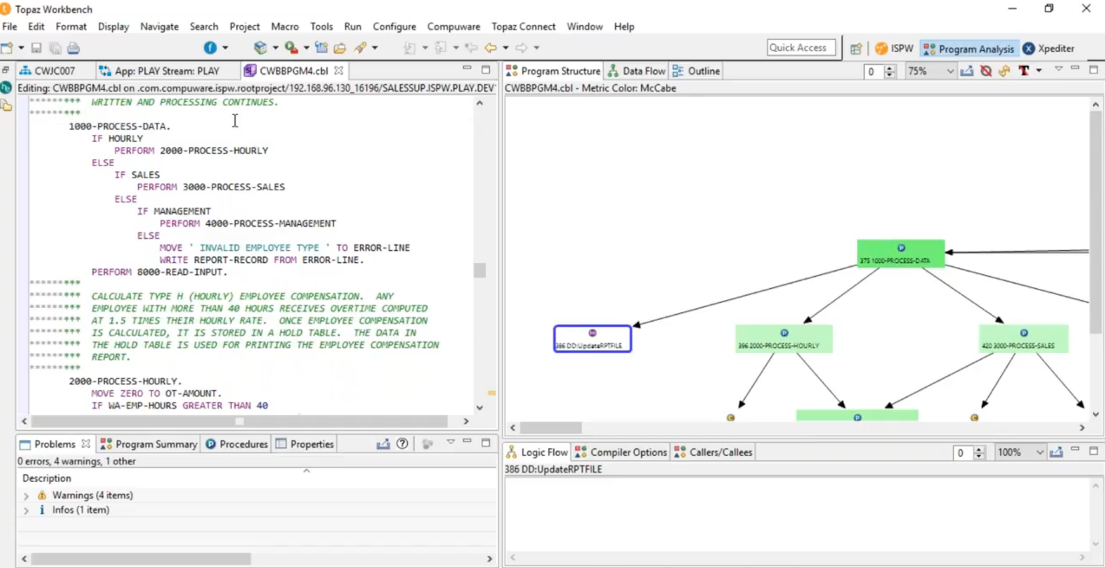
Mainframe DevOps Approach :Compuware Topaz & ISPW

Slide 15
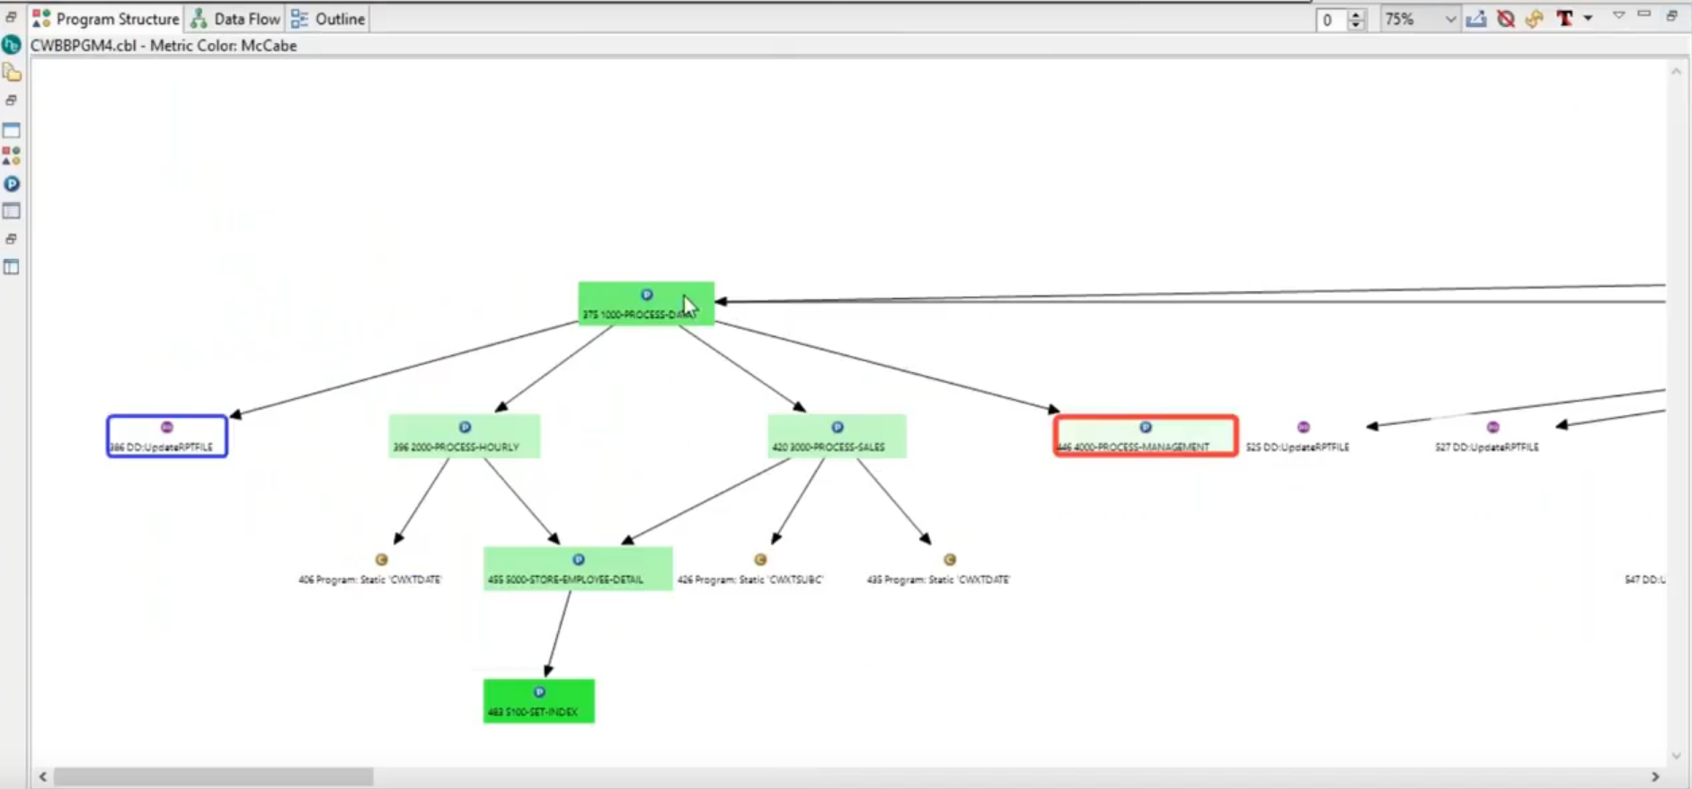
Mainframe DevOps Approach :Compuware Topaz & ISPW
Using the program analysis capabilities, complex applications can be understood using the visualization process.

Slide 16
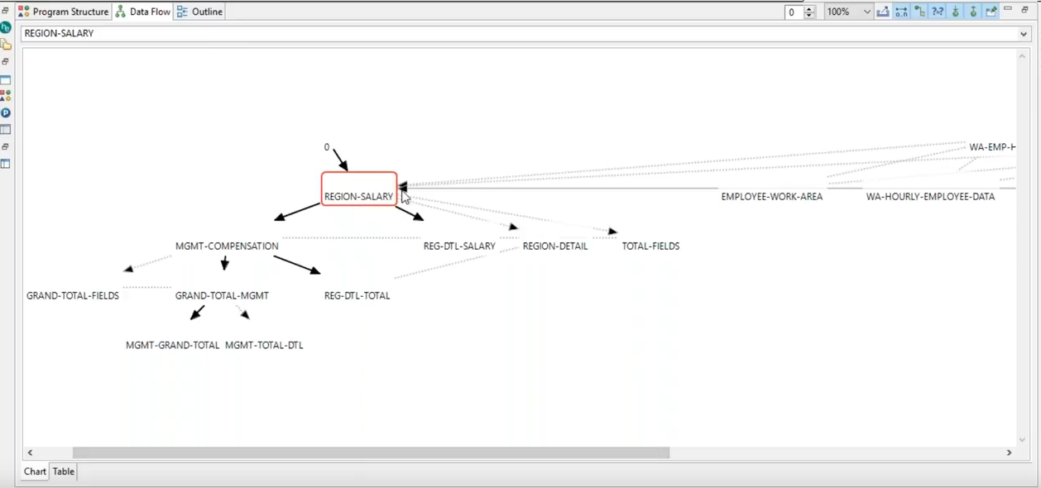
Mainframe DevOps Approach :Compuware Topaz & ISPW
Here we can able to see the data visualization to understand how data is flowing through.

Slide 17
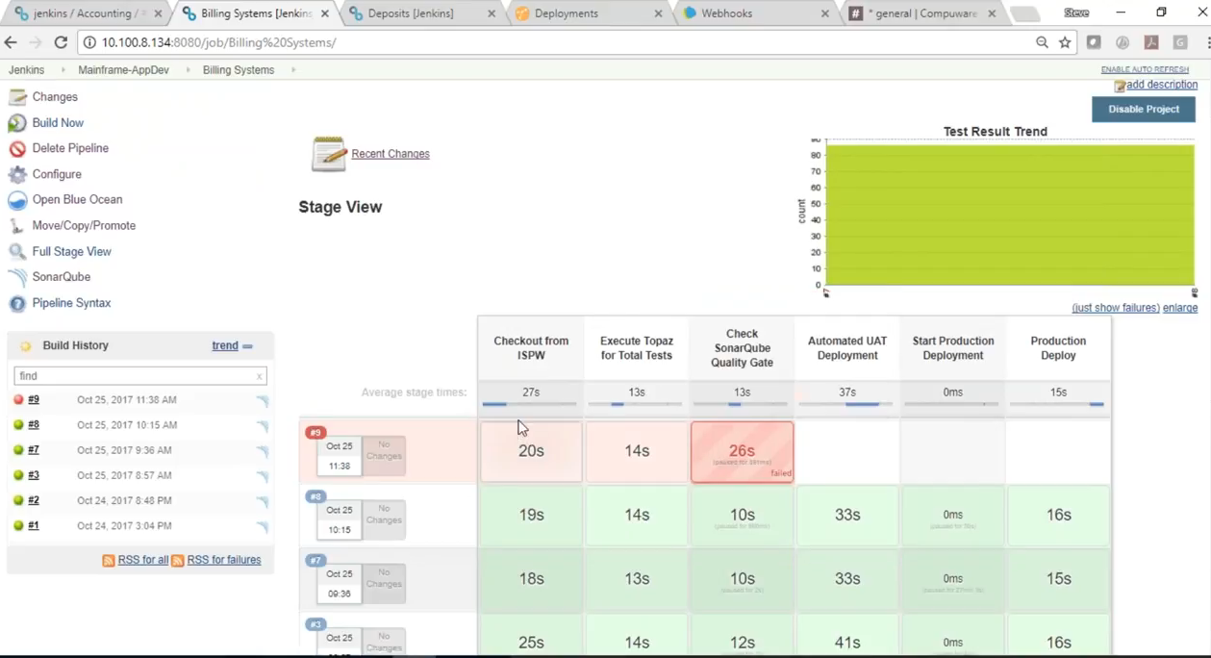
Mainframe DevOps Approach :Compuware Topaz & ISPW
Now as soon as code is checked-in the ISPW the Jenkins build pipeline will be triggered. Now in the case the build is failed due to test cases failed at Check SonarQube Quality Gate.
At the SonarQube side quality gate of 96% is set.

Slide 18
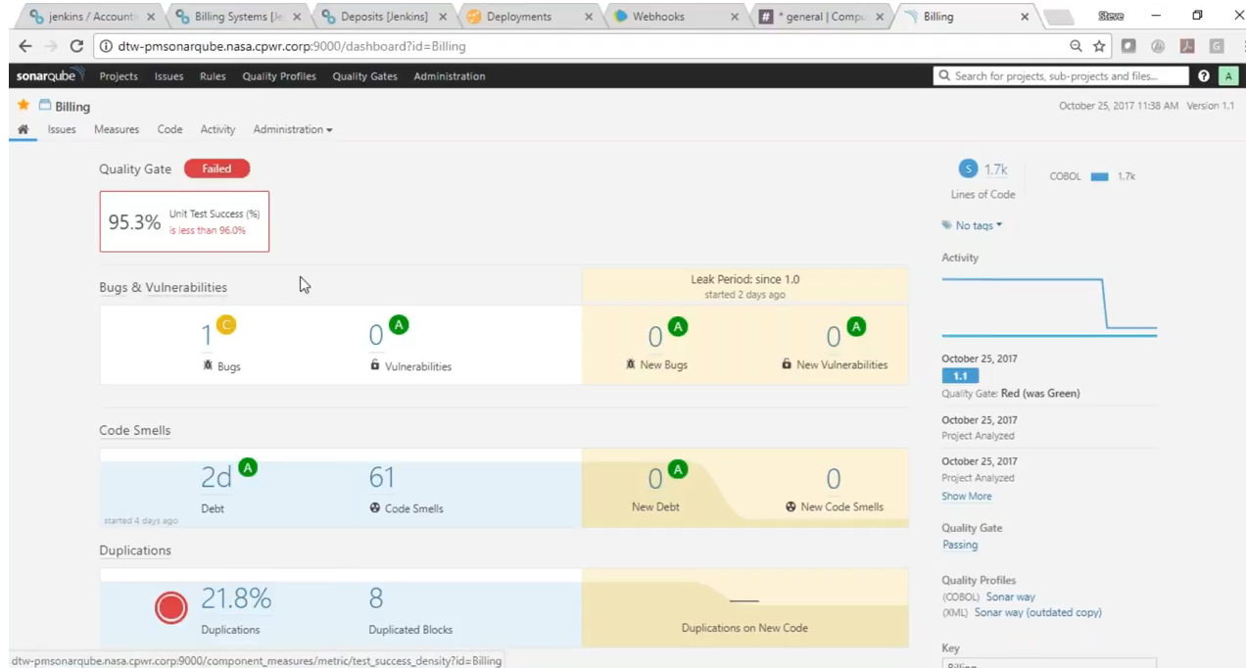
Mainframe DevOps Approach :Compuware Topaz & ISPW

Slide 19
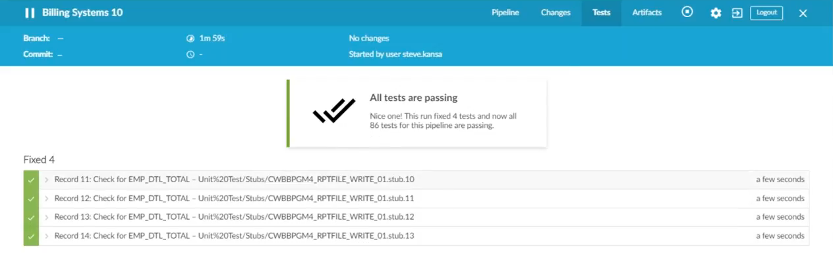
Mainframe DevOps Approach :Compuware Topaz & ISPW
After making the updates and checking in the updated code the Jenkins build will be triggered again and now will run successfully.
And above you can see that the pipeline view is showing All tests are passing.

Slide 20
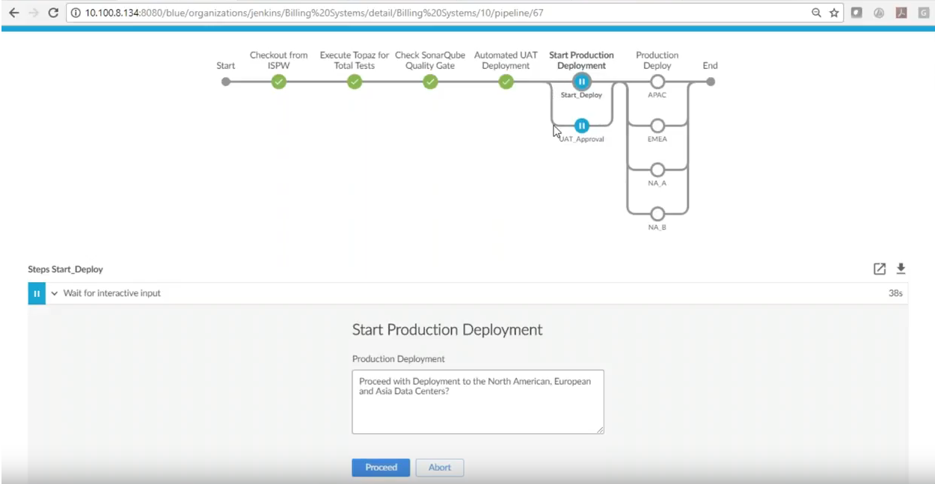
Mainframe DevOps Approach :Compuware Topaz & ISPW
Now before deploying the artifacts in the higher environment, an approval workflow will be triggered.
Once it is being approved, artifacts will be deployed in all the LPARs.

Slide 21
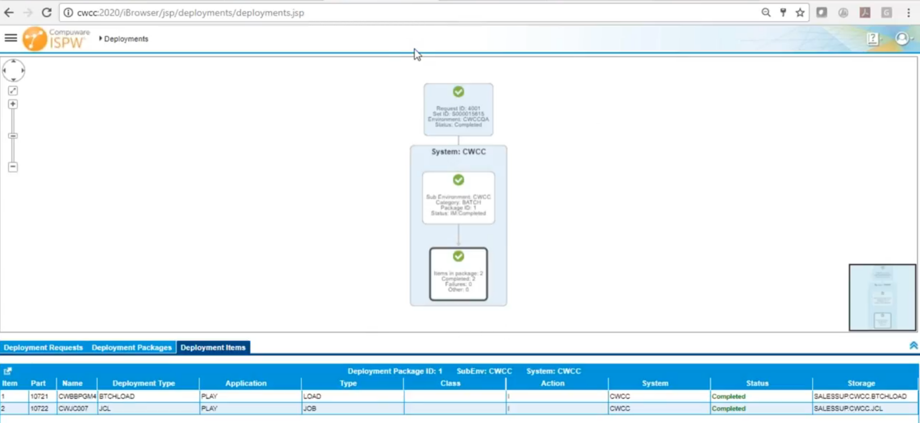
Mainframe DevOps Approach :Compuware Topaz & ISPW
The same deployment is available in ISPW also where you can see that both COBOL batch load and JCL is being deployed..

Slide 22
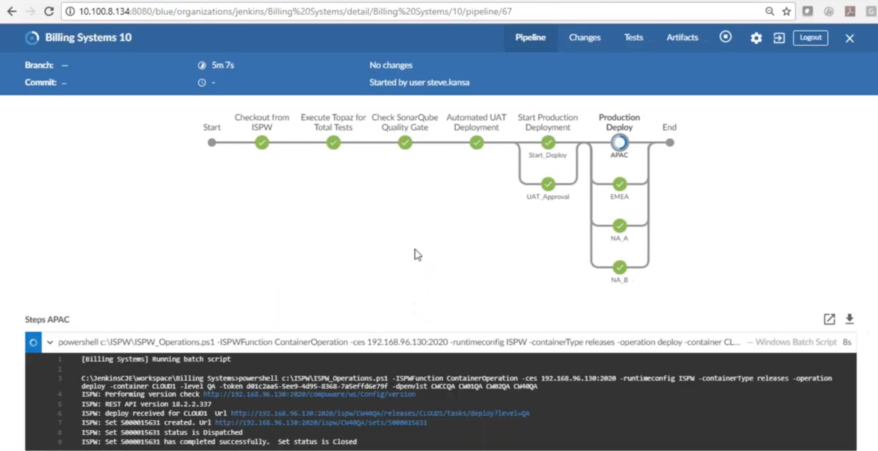
Mainframe DevOps Approach :Compuware Topaz & ISPW

Slide 23
Thank You

